Slide 1
01
Session 1 of 24
What data science is and how to think in it
What does a data scientist do, and what will you be able to do after 24 sessions?
Jotham Martin Wambi, KLAi Professional Learning
Session 1 What data science is and how to think in it
1
Notes:
Welcome, everyone, and well done for coming after a full day of work. Over the next twenty four sessions you'll learn how people turn data into decisions. You'll start in a spreadsheet, which you already know, and you'll finish with a tested model and a small app that a colleague can open. Today is the map. We look at what a data scientist does, how the work is organised, and which free tools we'll use. Then you open a workbook and run your first line of Python.

Slide 2
By the end of today
How the two hours run
Describe the data science lifecycle from question to decision.
Recall and warm-up
10 min
Concepts and explanation
30 min
Separate data science, machine learning and AI by what each produces.
Live demonstration
25 min
Break
5 min
Open Colab and run one cell.
Guided lab
40 min
Check and wrap-up
10 min
Session 1 What data science is and how to think in it
2
Notes:
By the end of today you'll be able to do three things. You'll describe the data science lifecycle, from a question to a decision. You'll tell data science, machine learning and artificial intelligence apart by what each one produces. And you'll open Colab and run a cell. Today is the lightest session of the course. The first part is pictures and plain talk, the live part is a look at the real Lakeside Mart workbook, and the lab starts in Sheets before it moves to your first notebook.

Slide 3
Vocabulary
Word | Plain meaning | In a spreadsheet
Data science | Using data, tools and careful thinking to answer a question and support a decision. | Analysing a workbook to advise your manager
Machine learning | A computer finding a rule from examples, instead of a person writing the rule. | A trend line that Sheets fits for you
Artificial intelligence | Any software that does something we would call smart. Machine learning is one way to build it. | No equivalent. A new idea.
Dataset | A collection of data about one subject, arranged in tables of rows and columns. | A workbook with its tabs
Model | A rule, found from data, that turns inputs into a prediction or an explanation. | A formula, but one found from past data
Lifecycle | The stages a data project passes through, from the question to the decision and the follow up. | The steps from a blank sheet to a report
Session 1 What data science is and how to think in it
3
Notes:
Here are the six words for today, and each has a spreadsheet cousin. Data science is the whole way of working, from question to decision. Machine learning is a computer finding a rule from examples. Artificial intelligence is the wide umbrella over it. A dataset is your workbook with its tabs. A model is a rule found from data. A lifecycle is the route a piece of work follows from start to finish. Look at the right hand column and you'll see you already know most of these ideas.

Slide 4
Warm-up: you and data
1
Name one task you would trust an AI tool with, and one you would always check.
Trust it with first drafts, summaries and ideas. Check every number, name, date and legal claim it gives you.
2
When did a number last decide something at your work? Where did it come from?
Often a spreadsheet that someone built. You will learn to build that evidence and test it yourself.
Session 1 What data science is and how to think in it
4
Notes:
Before I teach anything, two questions about your own experience with AI tools and with numbers at work.
First. Name one task you would happily trust an AI tool with, and one task where you would always check its answer. Have a think.
Most people say they trust it with a first draft of an email, a summary of a long document, or a list of ideas. And most people check anything with a number, a name, a date or a law in it. Hold on to that instinct. A good data scientist has the same instinct, and we'll build on it all course.
Second. When did a number last decide something at your work, and where did that number come from? No rush.
For most of you the answer is a spreadsheet that somebody built, sometimes years ago. In this course you'll learn to build that evidence yourself, and to test it before anyone relies on it.

Slide 5
Data science turns a question and data into a decision
It's a way of working. Someone asks, data answers, and a person decides.
Question
It starts with a decision someone has to make.
Data
Rows and columns that record what happened.
Method
Counting, charts, tests and sometimes a model.
Decision
It ends with advice a manager can act on.
Session 1 What data science is and how to think in it
5
Notes:
So what is data science? My answer is simple. It's a way of working that turns a question and some data into a decision.
It starts with a decision somebody has to make. Should we open a new branch? Should we change the price? Then you find the data that records what happened. That means rows and columns, the same as in your spreadsheets.
Then comes the method. Mostly that's counting, charts and careful comparisons. Sometimes it's a model, and we'll meet that word in a few minutes.
The work ends with advice that a manager can act on. A chart that nobody uses has failed. Keep that last box in mind, because it's the one people forget.

Slide 6
Dataset
A collection of data about one subject, arranged in tables of rows and columns.
In our data
In a spreadsheet
The Lakeside Mart workbook holds orders, order lines, branches, products and customers for eight shops in Uganda.
A workbook, with each tab as one table.
Session 1 What data science is and how to think in it
6
Notes:
Your first word. A dataset.
In plain words, it's a collection of data about one subject, arranged in tables of rows and columns.
We'll use a dataset for the whole course. Lakeside Mart is a fictional chain of eight shops across Uganda. Its dataset has tables for orders, the products on each order, the branches, the products and the customers. All of it is generated, so no real person or company appears in it.
You already know this idea. In Excel or Sheets, it's a workbook, and each tab is one table. When someone says dataset, picture a workbook.

Slide 7
The data science lifecycle
Question
Question. Name the decision and the question behind it.
Data. Find the tables that could answer it.
Monitor
Data
Clean and explore. Fix errors, then look at the shape of the data.
Lifecycle
Model. Test an idea or build a prediction.
Deliver
Clean and explore
Deliver. Explain the result to the person who decides.
Monitor. Check later that it still works.
Model
Session 1 What data science is and how to think in it
7
Notes:
The map for the whole course is a circle. We call it the lifecycle, which is the route a piece of work follows from start to finish.
Stage one is the question. You name the decision and the question behind it. A vague question wastes every stage after it.
Stage two is data. Which tables could answer the question, and can you actually get them?
Stage three is clean and explore. You fix the errors, then you look at the shape of the data. Expect this to take more of your time than anything else.
Stage four is the model. You test an idea, or you build a prediction.
Stage five is deliver. You explain the result to the person who decides, in words they use.
Stage six is monitor. Weeks later you check that the answer still holds, and that sends you back to a new question. Every session in this course sits somewhere on this circle.

Slide 8
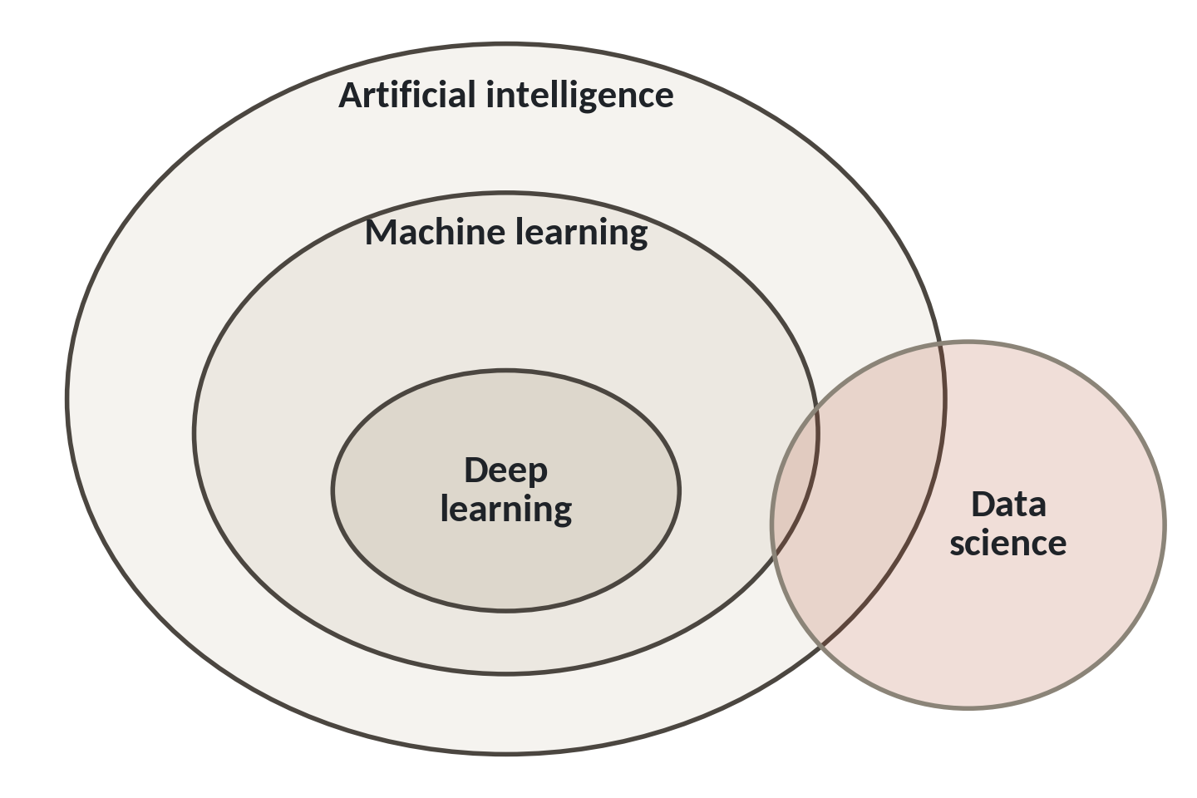
Artificial intelligence, machine learning and deep learning
1
Artificial intelligence is the biggest circle. It holds any software that does something we call smart.
2
Machine learning sits inside it. These programs find rules from examples.
3
Deep learning is the smallest circle. Data science overlaps all of them.
Data science is a way of working. Machine learning is one tool it uses.
Session 1 What data science is and how to think in it
8
Notes:
You hear three big words in the news. Artificial intelligence, machine learning and deep learning. One picture shows how they fit together.
The largest circle is artificial intelligence. It holds any software that does something we'd call smart. A spam filter counts. So does a chatbot.
Inside it sits machine learning. These are programs that find their own rules from examples, instead of a programmer typing every rule.
The smallest circle is deep learning. These are very large networks of simple calculations. They power voice recognition and image tools, and we meet them in Session 20.
Now look at the gold circle. Data science overlaps all of them, because it's a way of working. A data scientist uses machine learning when a model helps, and uses plain counting and charts when that's enough. Often it's enough.

Slide 9
A formula you write and a model that learns
Spreadsheet formula
Machine learning model
You write the rule
The computer finds the rule
Price times quantity gives revenue
Past loans show which ones defaulted
Same input, same output
Better examples give a better rule
A model is a rule found from data. You build your first one in Session 14.
Session 1 What data science is and how to think in it
9
Notes:
Let me make machine learning feel ordinary. Compare a formula with a model.
On the left, a spreadsheet formula. You know the rule, so you write it. Price times quantity gives revenue. Same input, same answer, every time.
First point on the right. With machine learning, you don't know the rule, so the computer finds it. You give it examples, and it works out the pattern.
Take a microfinance lender. It has records of past loans, and each one is marked as repaid or defaulted. No person can write the exact rule that separates them. A model studies the records and finds a rule that does a reasonable job.
And the quality of the rule depends on the quality of the examples. Poor records give a poor rule. That's why most of this course is about data.
So a model is a rule found from data. In Session 14 you'll build one.

Slide 10
Three roles on a data team
Small organisations often give one person all three jobs. You will practise the first two.
Analyst
Answers questions about the past with tables and charts.
Data scientist
Tests ideas and builds models that explain or predict.
ML engineer
Puts a model into a product and keeps it running.
Session 1 What data science is and how to think in it
10
Notes:
Who does all this work? On a larger team, three different roles.
The analyst answers questions about the past. How many orders did Jinja take last month? Which products sell best? The tools are tables, pivots, SQL and charts. Many of you do part of this job already.
The data scientist goes further. This person tests ideas, such as whether a promotion really lifted sales, and builds models that explain or predict.
The machine learning engineer takes a working model and puts it into a product, then keeps it running and watches it. That person makes sure a model keeps working for a whole team, every day.
In many Ugandan organisations, one person does all three jobs. So we'll practise the analyst and data scientist work properly, and we'll touch the engineer work in Session 23.

Slide 11
A business question worth asking
Weak: Tell me about sales
Strong: Which branch needs help?
No decision attached
Names what to measure
No number to find
Names the decision it feeds
No sign of when you are done
Needs data you can get
Write the decision first. Then write the question.
Session 1 What data science is and how to think in it
11
Notes:
Now a skill that needs no code at all. Asking a good question.
On the left, a weak question. Tell me about sales. It could take a week, and at the end nobody knows if you answered it.
Under it, the first problem is that no decision is attached. Nobody knows what they'd do with the answer. There's also no particular number to find, and no sign of when you're finished.
On the right, a strong question. Which branch should the regional manager visit first? It names what to measure, and it names the decision it feeds. And it needs data that we can actually get.
So write down the decision first, then write the question. At the end of today's lab, you'll write a question of your own from your own work.

Slide 12
Real data first: the Lakeside Mart workbook
2,000
orders on the orders tab
6,590
order lines on the order_lines tab
8
branches across Uganda
150
products on the products tab
A 2,000-order sample, so it opens quickly in Sheets. All of it is fictional.
Session 1 What data science is and how to think in it
12
Notes:
Here is the workbook you'll open in the lab.
It holds two thousand orders. Each order has one or more lines, one for every product bought, and there are six thousand five hundred and ninety lines in all. There are eight branches across Uganda and a hundred and fifty products.
This is a sample of the full Lakeside Mart data, so it opens fast in Sheets. The full files have thirty thousand orders, and we'll use those in Python later. Because of that, answers from this sample will differ a little from answers from the full files. That difference is the topic of Session 4.
Every name and number is made up. Nobody's real shop, customer or till receipt is in here.

Slide 13
A confident answer that nobody checked
What it looks like
Why it goes wrong
The fix
You ask a chat assistant what share of customers pay by mobile money. It replies with a clean percentage in a friendly tone. You paste it into your report.
A chat assistant predicts likely words. It can state a figure it never calculated, and nothing in its tone tells you which figures are real.
Ask it for the method. Work out the number yourself from your own data, and write the source beside it.
Session 1 What data science is and how to think in it
13
Notes:
Today's trap connects to your warm-up answers. A trap is a mistake that runs without any error.
You ask a free chat assistant what share of customers pay by mobile money. It gives you a tidy percentage, politely. You paste it into your report. Nothing warns you.
The reason is how these tools work. They predict likely words. A figure that looks right is a likely sequence of words, whether or not anyone calculated it. Its tone is equally confident when it's right and when it's wrong.
So ask it for the method. Then calculate the number from your own data, and write the source next to the figure. We'll use assistants through the course for explaining errors and suggesting code, and we'll always check them.

Slide 14
The free toolset
Tool | What you use it for | Cost
Google Colab | Python notebooks in your browser | Free, with a Google account
Sheets, Excel or LibreOffice | Tables, pivots and charts | Free, or what you own
pandas, scikit-learn, matplotlib | Data work, models and charts | Free, open source
SQLite | Questions to a database | Free, inside Python
GitHub | Save and share your work | Free account
Streamlit Community Cloud | A small web app for your model | Free for public apps
Every tool here is free for you and for the tutor.
Session 1 What data science is and how to think in it
14
Notes:
Now the tools. Everything here is free, for you and for me.
Google Colab runs Python in your browser, so Windows and Mac laptops behave the same. You need a free Google account and nothing to install.
For spreadsheets, use Google Sheets, or Excel or LibreOffice if you have them. Any one of them works.
The Python libraries do the data work. pandas handles tables, scikit-learn builds models, and matplotlib draws charts. SQLite lets you question a database with no server. GitHub keeps and shares your work, and Streamlit Community Cloud turns a model into a small web app.
Every item on this list costs you nothing. If you ever see a step that asks for a credit card, tell me, because it doesn't belong in this course.

Slide 15
Colab is free, and it has limits
Plan for the limits from day one and a lost session costs you very little.
Idle time
A free session ends after you stop working for a while.
Length
A session ends after about 12 hours at most.
Quota
Google does not publish the limits, and they can change.
Save
Keep your notebooks in Drive or on GitHub.
Session 1 What data science is and how to think in it
15
Notes:
Free tools have limits, and it's better you hear them from me than discover them at ten at night.
First, idle time. If you stop working for a while, Colab ends your session, and the values in memory vanish.
Second, length. Even if you keep working, a free session ends after about twelve hours at most. We won't come close in class.
Third, quota. Google doesn't publish exact limits for free users, and they can change from week to week. So if a session misbehaves, it may be the quota, and your code may be fine.
The answer to all three is the same. Save your notebooks in Google Drive, or on GitHub when we get there. Save your work often. Anything saved to Drive comes back when you open it again. Anything you only held in memory does not.

Slide 16
Your first Colab cell
Open
Run
Read
Edit
Save
Open the Session 1 notebook in Colab.
Press the play button beside a cell.
The answer appears under the cell.
Change a word or number and run again.
Save a copy to your Drive.
A cell is a box of Python. Run it, read it, change it, save it.
Session 1 What data science is and how to think in it
16
Notes:
Let me show you the rhythm of a notebook before you try it. A notebook is made of cells, and a cell is a box that holds a few lines of Python. Think of it as one cell of a spreadsheet that can hold a whole instruction.
First you open the notebook. I'll give you the link for Session 1.
Then you run a cell by pressing the play button on its left. Python reads the lines and does what they say.
The result appears right under the cell. Read it. If something is wrong, Python tells you there, in words.
Then you edit. Change a word or a number and run the cell again. You can't break anything by doing that. The worst case is an error message, and we'll learn to read those in Session 5.
Finally, save a copy to your own Drive, so the work is yours and survives the idle timeout.

Slide 17
This course covers a path through the field
48 hours
This course: 24 sessions of 2 hours
About 150 to 240 hours
Each Google or IBM data certificate
So we choose the working core: Sheets, Python, SQL, inference, models and one small app.
Session 1 What data science is and how to think in it
17
Notes:
You'll meet other courses online, so let me put this one beside them. The Google and IBM data certificates each ask for somewhere between a hundred and fifty and two hundred and forty hours, depending on the source. This course is forty eight.
That gap is a choice. We can't cover everything in forty eight hours, so we cover a path. It's the working core. You'll get Sheets for thinking, Python and pandas for handling data, SQL for databases, enough statistics to say whether a difference is real, machine learning for prediction, and one small app to show it.
What we leave out, we say so. In Session 24 we list what the course skipped, and you build a six month plan with free courses to fill your own gaps.

Slide 18
Lab: open the workbook and run your first cell
1
Open lakeside_for_sheets.xlsx in Sheets
Tool and time
Google Sheets and Google Colab
40 minutes
2
On each tab, find the number of rows and columns
3
Name the grain of each tab: what is one row?
You are done when
You have a table of rows, columns and grain, three working cells, and one question of your own.
4
Open the Session 1 notebook in Colab and run the setup cell
5
Print a sentence, add two numbers, store a list, save a copy
6
Write your own business question
Session 1 What data science is and how to think in it
18
Notes:
The first task is in Sheets. Open the Lakeside Mart workbook and find how many rows and columns each tab has, then write down its grain. Grain is a short word for what one row stands for. On the orders tab, one row is one till order. Do the same for every tab, and don't count the header row as data.
The second part is in Colab. Open the Session 1 notebook and run the setup cell first. Then do three small tasks. Print a sentence, add two numbers, and store a list. Each task has a check cell under it that tells you whether you got it right.
Finish by writing a business question from your own work, with the decision it would feed. I'll come round and read a few. If you get stuck, ask me.

Slide 19
Questions to finish
1
Name the six stages of the lifecycle, in order.
Question, data, clean and explore, model, deliver, monitor.
2
How do artificial intelligence, machine learning and deep learning fit together?
Machine learning sits inside artificial intelligence. Deep learning sits inside machine learning.
3
Why did this course choose a path of 48 hours?
Certificates run about 150 to 240 hours. We cover the working core and list what we left out.
Session 1 What data science is and how to think in it
19
Notes:
Let's test the map. Name the six stages of the lifecycle, in order. Take your time.
Question, data, clean and explore, model, deliver, and monitor. Then it loops back to a new question.
Next, how do artificial intelligence, machine learning and deep learning fit together? Think it over.
Machine learning sits inside artificial intelligence, and deep learning sits inside machine learning. Data science overlaps all three.
Last, why is this course forty eight hours when the certificates run a hundred and fifty to two hundred and forty, depending on the source? Give that a moment.
Because it covers a path. It teaches the working core and tells you plainly what it leaves out.

Slide 20
Summary
Data science runs a lifecycle: question, data, clean and explore, model, deliver, monitor.
Machine learning is one tool inside artificial intelligence. A model is a rule found from data.
Write the decision first, then the question. Check any number you did not calculate.
Next session. Data as tables: rows, columns and grain
Session 1 What data science is and how to think in it
20
Notes:
One. Data science runs a lifecycle, from a question to a decision, and then a check that it still works.
Two. Machine learning is one tool inside the wider world of artificial intelligence, and a model is a rule that was found from data.
Three. Write the decision first, then the question. And check any number that you didn't calculate yourself.
Next session we go deeper into tables. We ask exactly what one row means, how one table connects to another, and how to read a data dictionary. Today's grain exercise was the first taste of it. Please bring your notes from the Sheets part of the lab.

